Slide 1


Getting To Know the disAbility Service
Trinity College Dublin
Ability I Inclusion I Belonging

Slide 2

What is the disAbility Service?
The Disability Service is a team of experienced individuals who work to support disabled students attending Trinity College.
  Occupational Therapists.
  Assistive Technology Officer.
  Disability Officers.
  Academic support specialists.
  Administrative Staff.

Slide 3



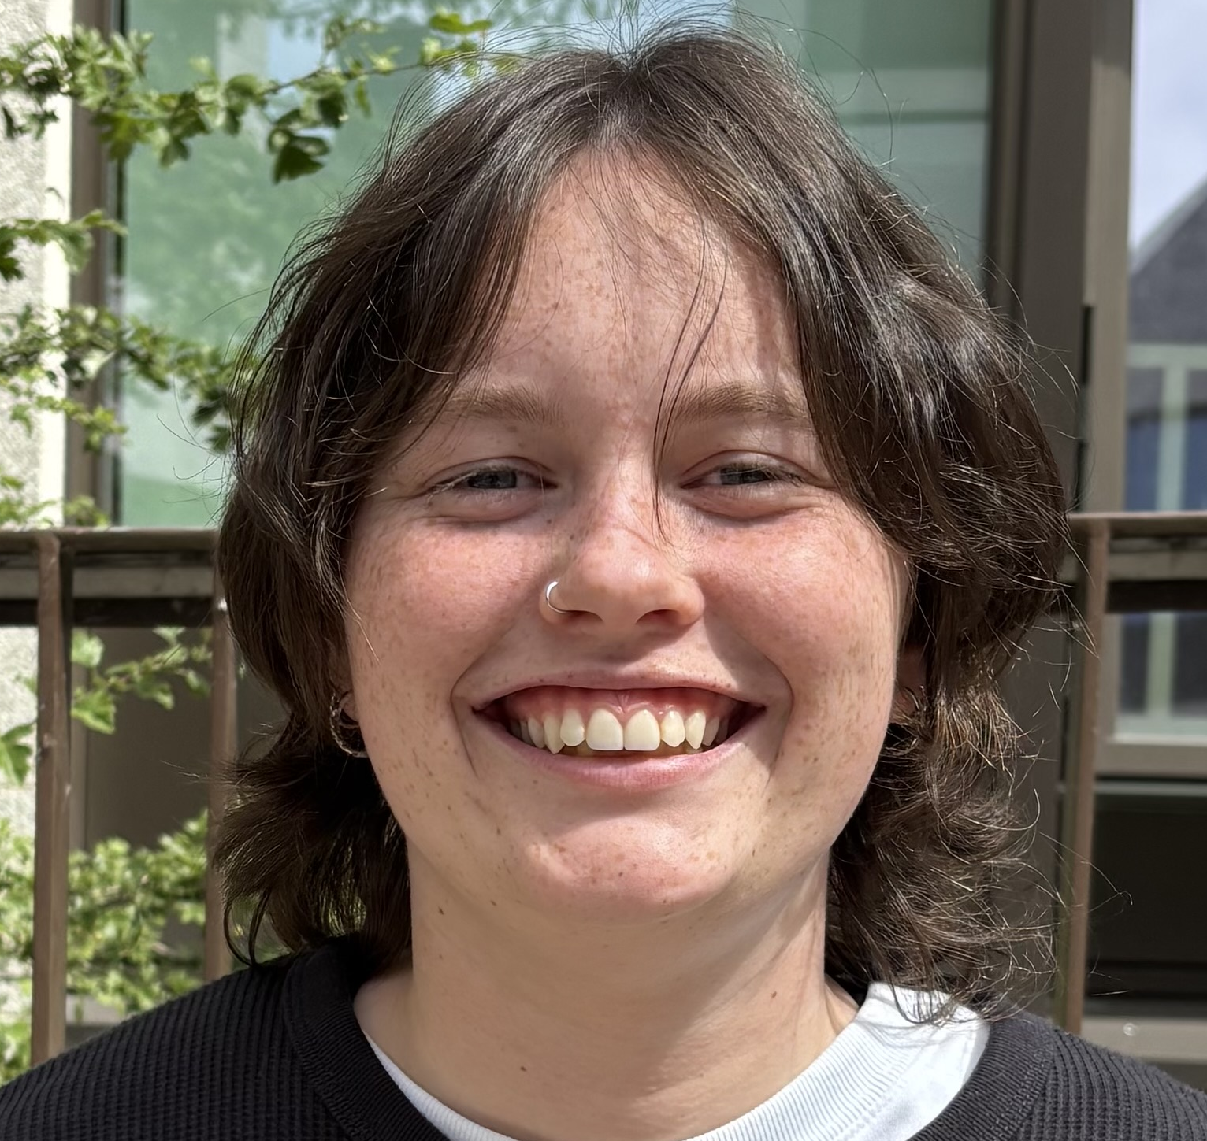
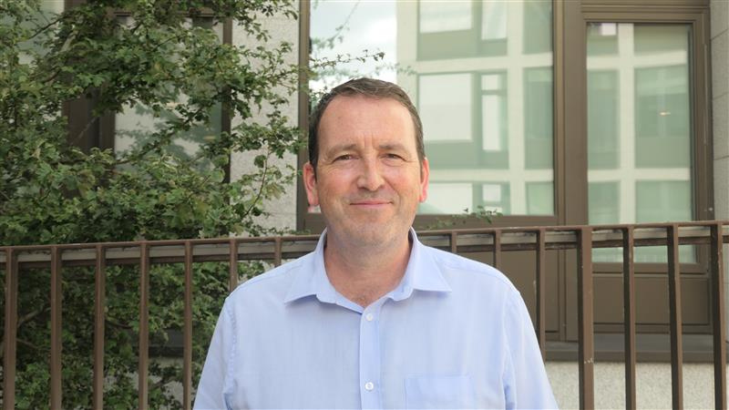
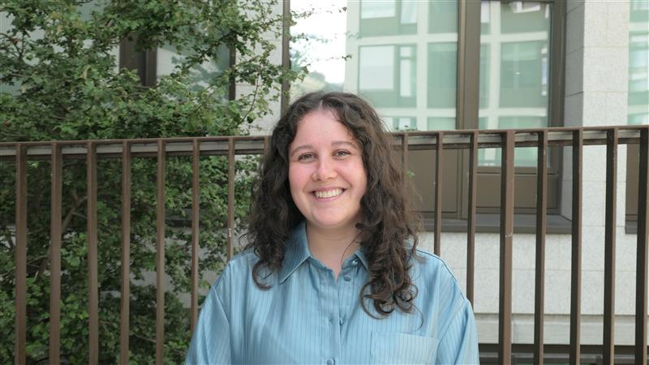
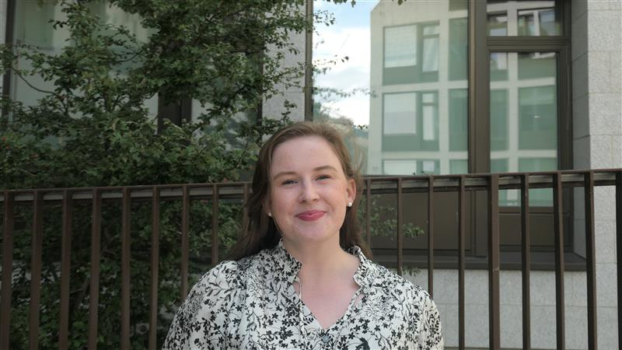








Staff Introductions
Admin and Assistive Technology Team
Director of Disability Service
Disability Supports Team
Mental Health and Wellbeing Team

Slide 4
Who can register with the disAbility Service?
Mental Health Condition
Significant Ongoing Illness
Dyspraxia
SpLD
  Students with confirmed or suspected disabilities can register with the Disability Service to access supports.
  You may have received supports for your disability in the past, or this might be your first experience with reasonable accommodation.
Neurological Condition
Physical
Deaf/Hard of Hearing
Blind/Visually Impaired
Autism
ADD/ADHD

Slide 5

What is a reasonable accommodation?
Reasonable accommodations should alleviate substantial disadvantages that disabled students may otherwise experience.​
They are agreed in collaboration with students​
For example:​
  Additional time in exams​
  Smaller exam venues ​
  Permission to record lectures​
  Access to respite spaces​
  Use of assistive technology ​
  Occupational Therapy support ​

Slide 6

Reasonable Accommodation Policy
  Ensures fair access – not unfair advantage
  Based on equality law & best practice
  Applies to all teaching & assessment
  By registering, you agree to the policy so supports can be put in place
Scan this QR code to read

Slide 7
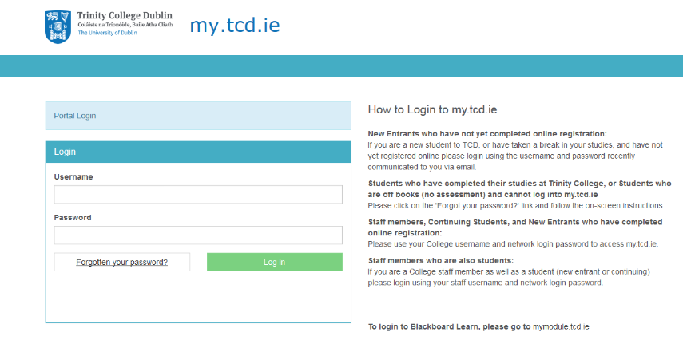
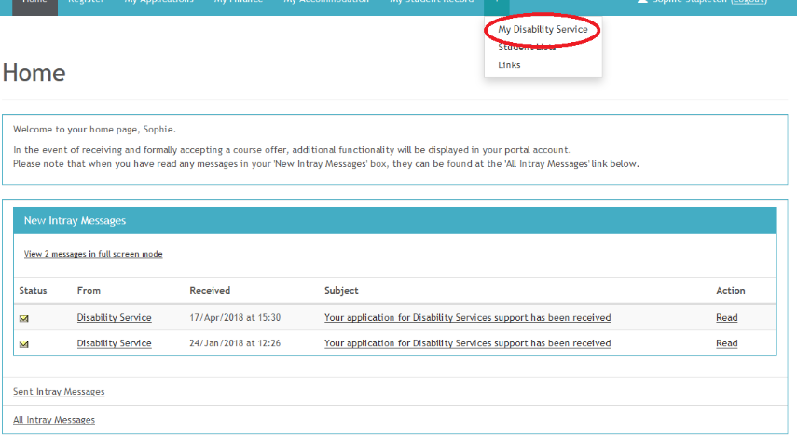
How to Register for Reasonable Accommodations
2. Click the “My Disability Service” tab under the “+” sign
1. Log into my.tcd.ie

Slide 8
How to Register for Reasonable Accommodations
Select your Primary and Secondary Disability
Agree to our policies
Choose whether or not you would like exam accommodations
Upload your evidence of disability
Remember to submit your application!

Slide 9
APPLICATION DEADLINE FOR EXAM ACCOMMODATIONS!
October 30th 2026

Slide 10
The Needs Assessment Process
Your application is reviewed
You are offered initial reasonable accommodations
You are emailed regarding the next steps
You approve/query your LENS
You are offered a needs assessment meeting with a Disability Officer

Slide 11
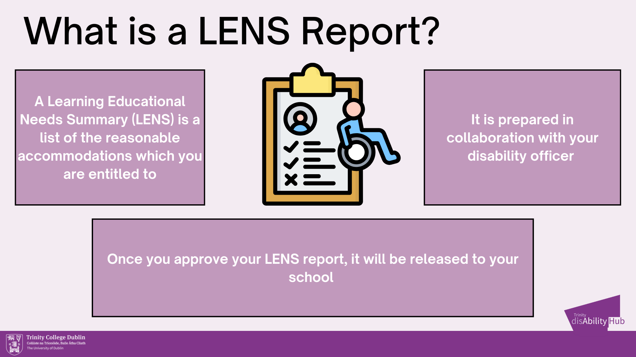
The LENS Report
All LENS Reports have a set of “initial” accommodations listed – further accommodations can be discussed and agreed in collaboration with your Disability Officer
Your application is reviewed
You are offered standard reasonable accommodations
You are emailed regarding the next steps
You approve/query your LENS
You are offered a needs assessment meeting with a Disability Officer

Slide 12
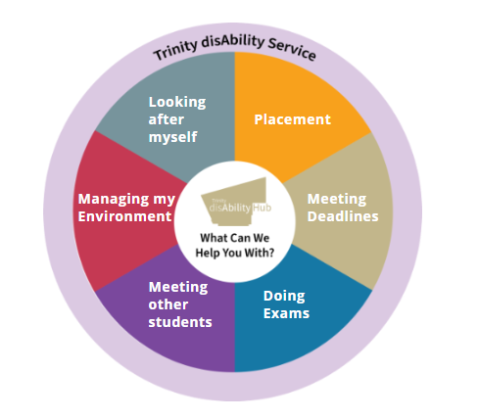
What Can the disAbility Service Help Me With?

Slide 13

How We Can Help
Exams and Assessments
Workload and Deadline Management
Managing your Environment
Placement and Careers
1:1 and Group Supports

Slide 14




Student Community
Through Clubs, Societies, and Student Advocacy Groups you have the chance to meet other students and help shape inclusion in Trinity

Slide 15




Looking After Yourself - Your Wellbeing Matters!

Slide 16

If you would like to discuss further…

Slide 17

.
How to contact the disAbility Service
  Student portal – ask.tcd.ie/disability.
  Email – askds@tcd.ie.
  Visit us at the disAbility Hub in Printing House Square.

